Slide 1

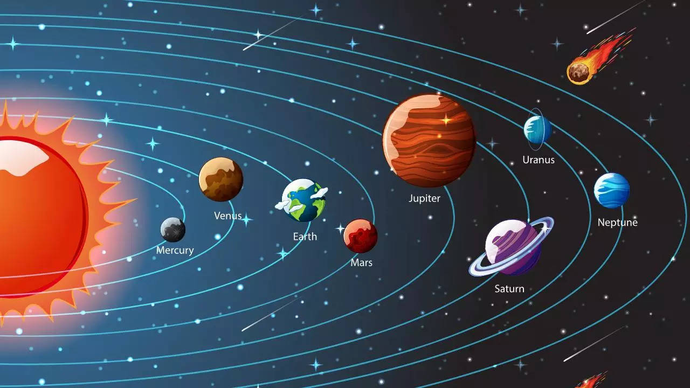
Today
About

Slide 2

Solar System => “Solar” =>” Solis” (Sun in Latin)
Situated in Milky-way Galaxy’s Orion Arm / Orion Spur, between two major arm Sagittarius & Perseus.
Orion arm is of 2 to 4 light years in diameter.
Orbit around center of galaxy at 8,28,000km/h for about 230million years.
27,000 light years away from galactic center.
Solar system live

Slide 3
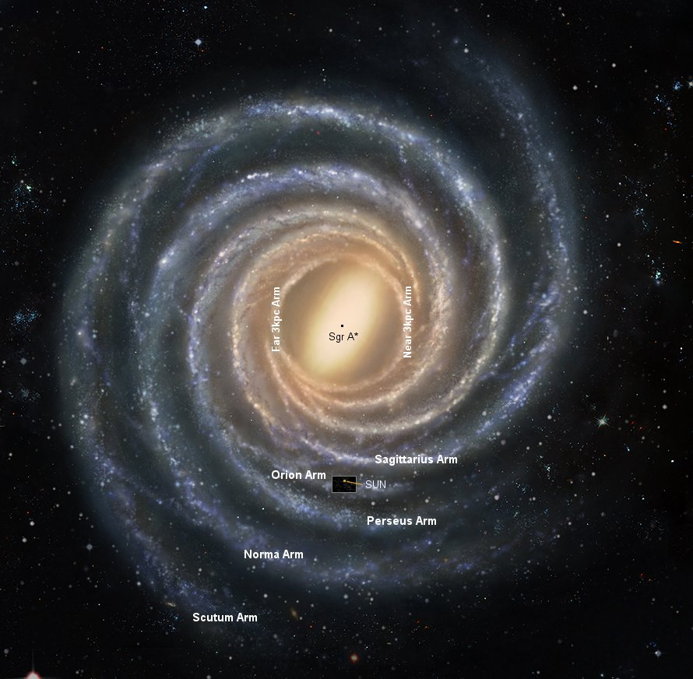
Where are we in galaxy……..

Slide 4
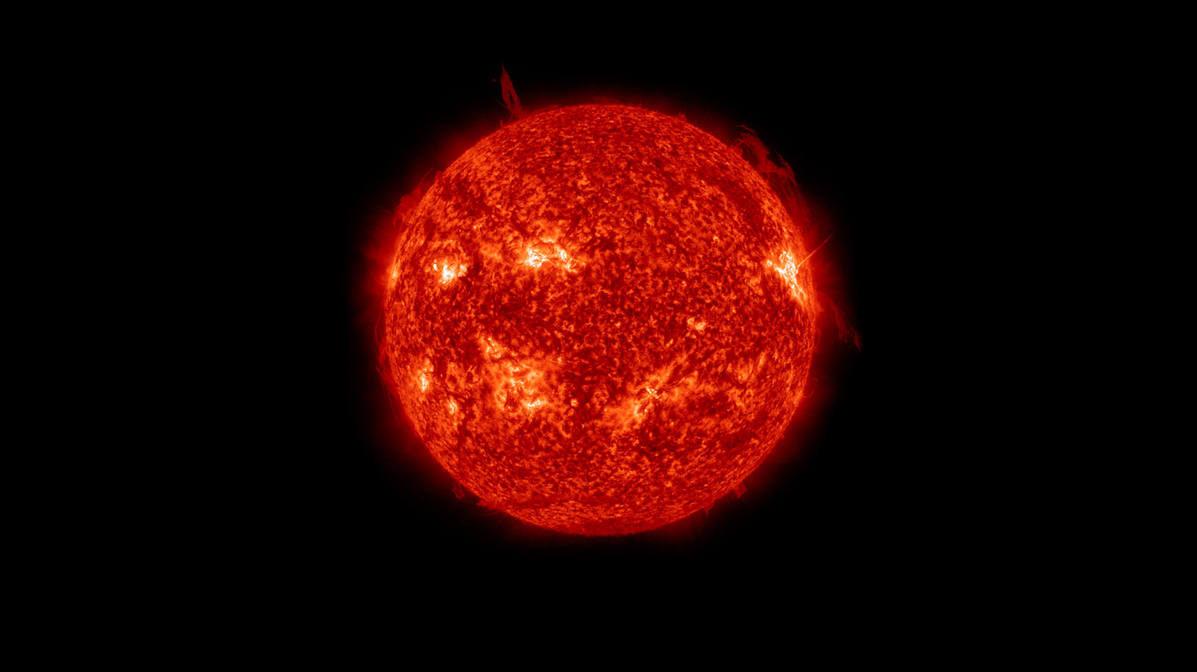
Bonding Manager

Slide 5

Center of our system.
Sun’s gravity field holds our system which is about 274m/s².
Heliophysics => study of sun.
G2V => scientific name of our sun.
Radius of 7,00,000km.
The fact that our Sun and the stars all have similar compositions and are made up of mostly hydrogen and helium was first shown in a brilliant thesis in 1925 by Cecilia Payne-Gaposchkin, the first woman to get a PhD in astronomy in the United States

Slide 6
Element | Abundance (pct. of total number of atoms) | Abundance (pct. of total mass)
Hydrogen | 91.2 | 71.0
Helium | 8.7 | 27.1
Oxygen | 0.078 | 0.97
Carbon | 0.043 | 0.40
Nitrogen | 0.0088 | 0.096
Silicon | 0.0045 | 0.099
Magnesium | 0.0038 | 0.076
Neon | 0.0035 | 0.058
Iron | 0.030 | 0.014
Sulfur | 0.015 | 0.040

Slide 7
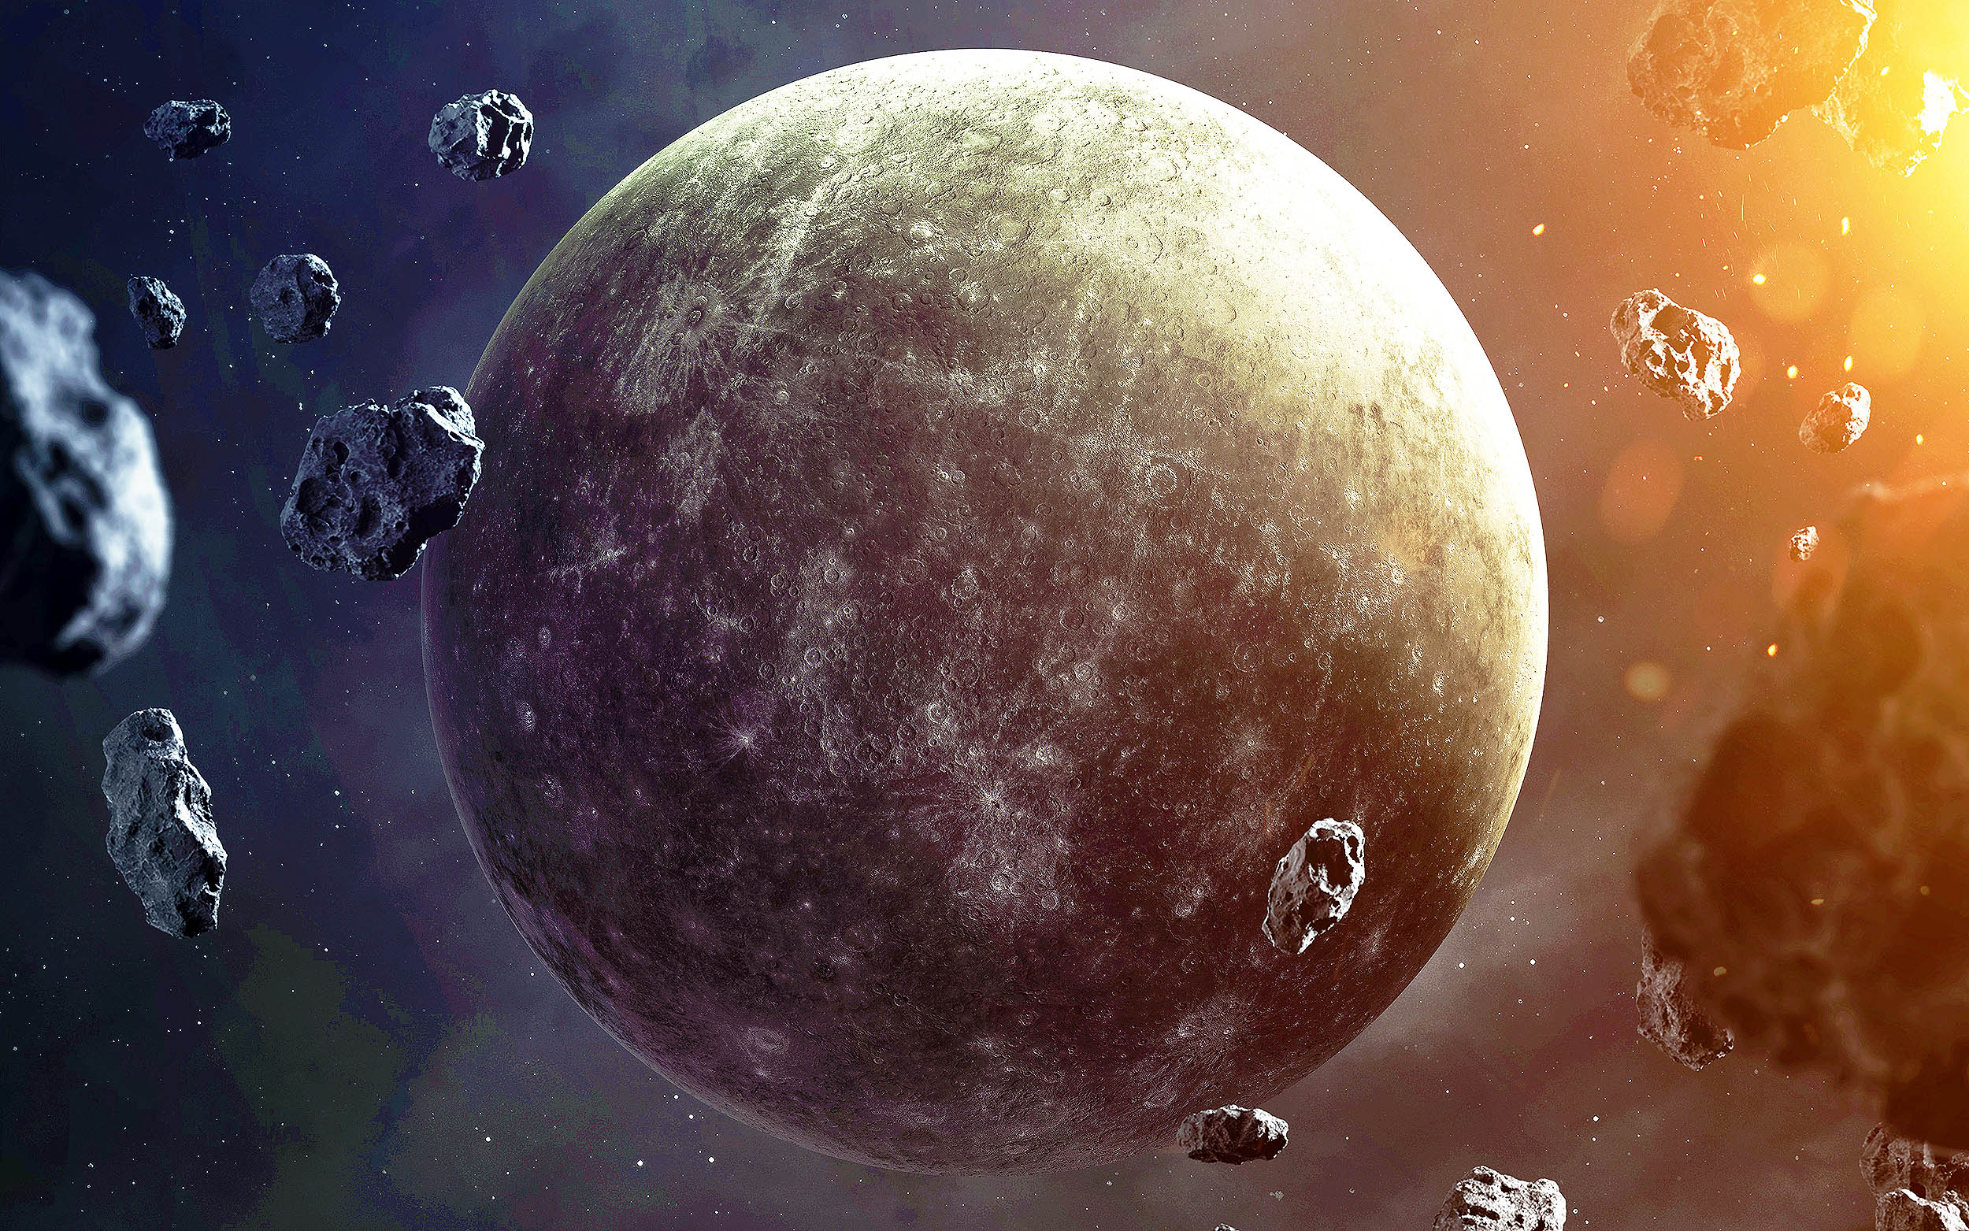
Speedster

Slide 8


Closest to Sun.
Roman God Mercury who was swift messenger.
Radius of 2,440km; Mass 3.30 x 10²³kg.
88 days for; 57.91 million km from sun.
Day length of 58 earth days.
Temp: -173ºC at night; 427ºC at day.
Around 47.87 km/s orbital speed.
Terrestrial planet; Core => Iron (liquid & solid); Mantle => Silicon; Crust => Silicon.
Water in ice form as low atmospheric pressure.
Weak magnetic and gravity field.

Slide 9
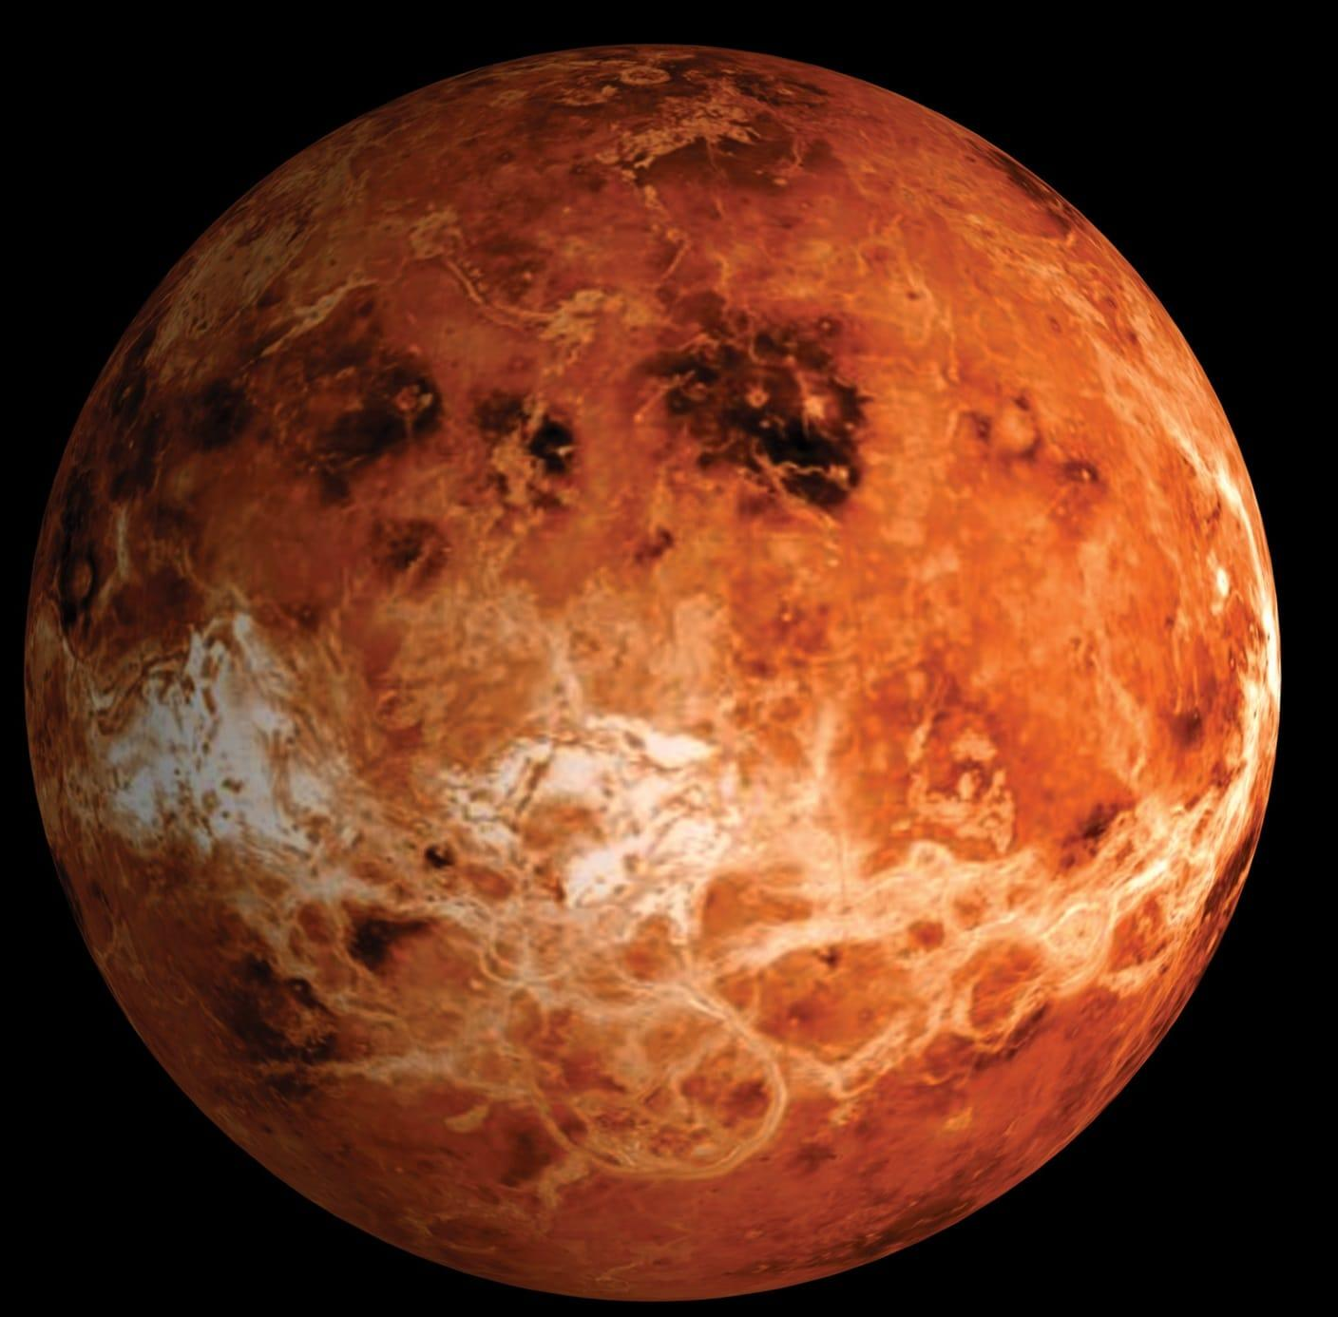
Hottest

Slide 10


Densest planet; 108.2 million km from sun.
Diameter of 12,104km; Temperature of 462ºC.
Day length of 243 earth days.
Orbital time of 225 earth days in the speed of 35.02km/s in opposite direction.
Name from Roman god of love and beauty.
Atmosphere 96.5% of CO2.

Slide 11
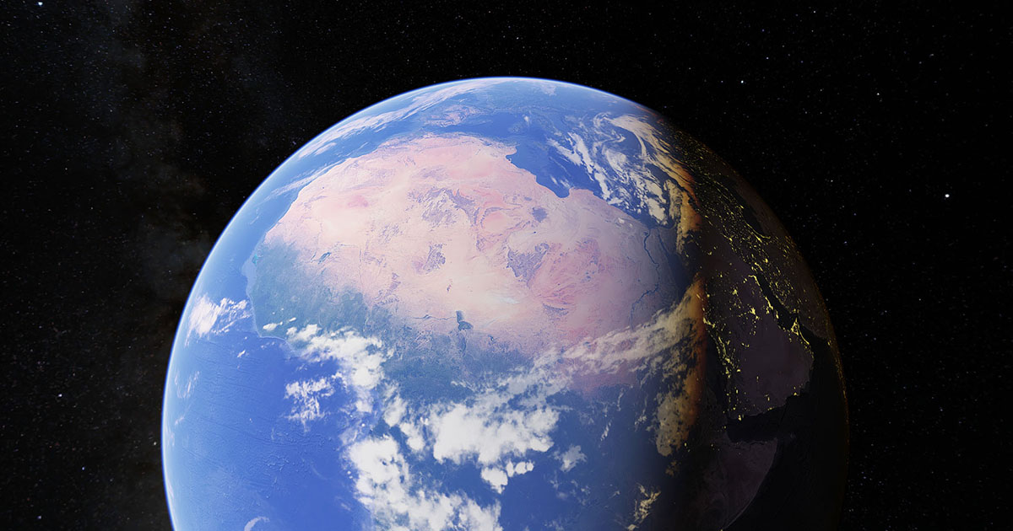

Slide 12

Fifth largest. Earth => English word mean soil or ground.
Habitable Planet; Three Layers – Core, Mantel, Lithosphere.
Geoid shape; 12,760 km of radius; 150 million km from sun (1AU)
Atmosphere: 78% nitrogen, 21% oxygen, 1% others.
Strong magnetic field and perfect gravity field.
About 1 to 1.5 billion years earth become inhabitable planet.
Live earth

Slide 13

Goldilocks Zone
Habitable zone.
Water stay as liquid in this planet.
0.95AU to 1.7AU in our solar system.
Earth lies in the zone where Venus in inner edge and mars at outer edge.
Habitable Zone not fixed.
Expand or Compress with star property of luminous and heat.

Slide 14
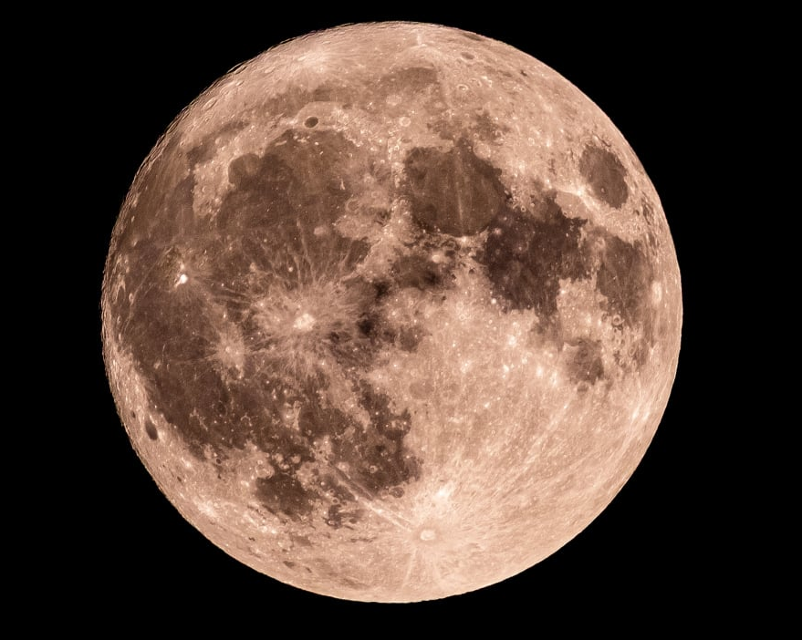

Slide 15
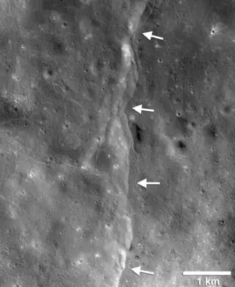
Closest to us; 3475km of diameter; 3,82,500km distance.
Gravity of 1.6 m/s².
Temperature: day 273°F (134°C) and night 243°F (-153°C).
Control Water motion and Climate and Angle of drift.
Moon View.

Slide 16
Elements | Percentage %
Oxygen | 43
Silicon | 20
Magnesium | 19
Iron | 10
Aluminum | 3
Chromium | 0.42
Titanium | 0.18
Manganese | 0.12

Slide 17
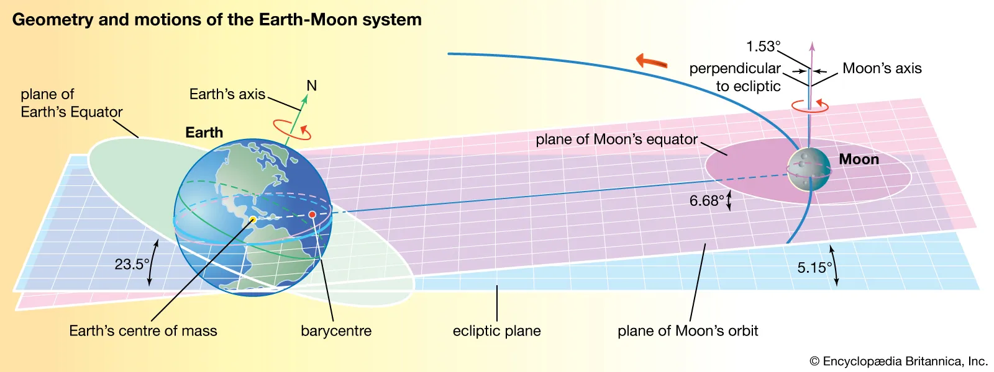

Slide 18
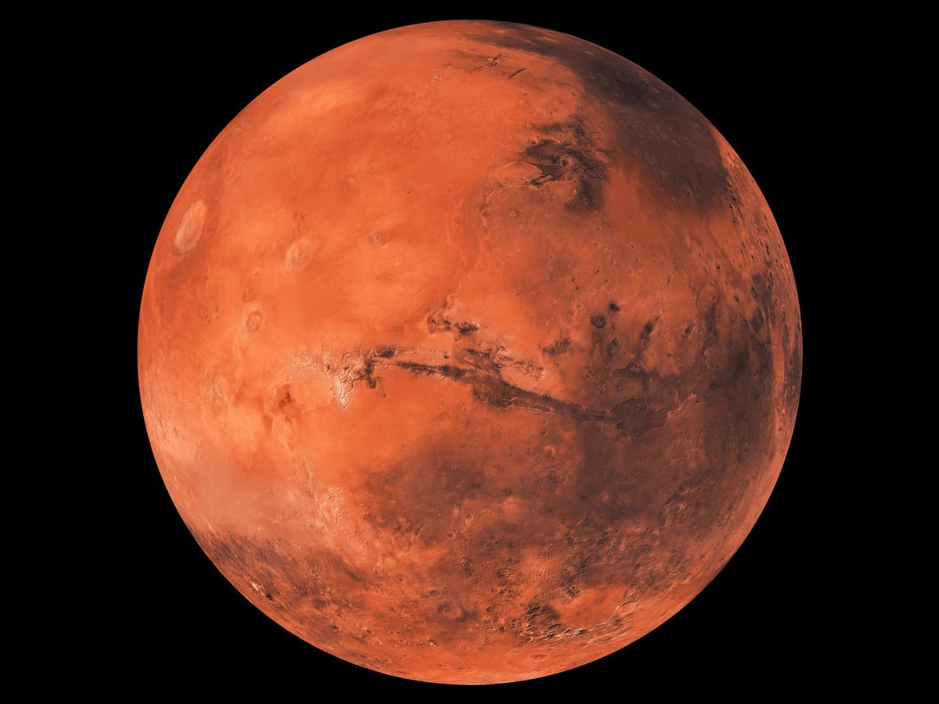
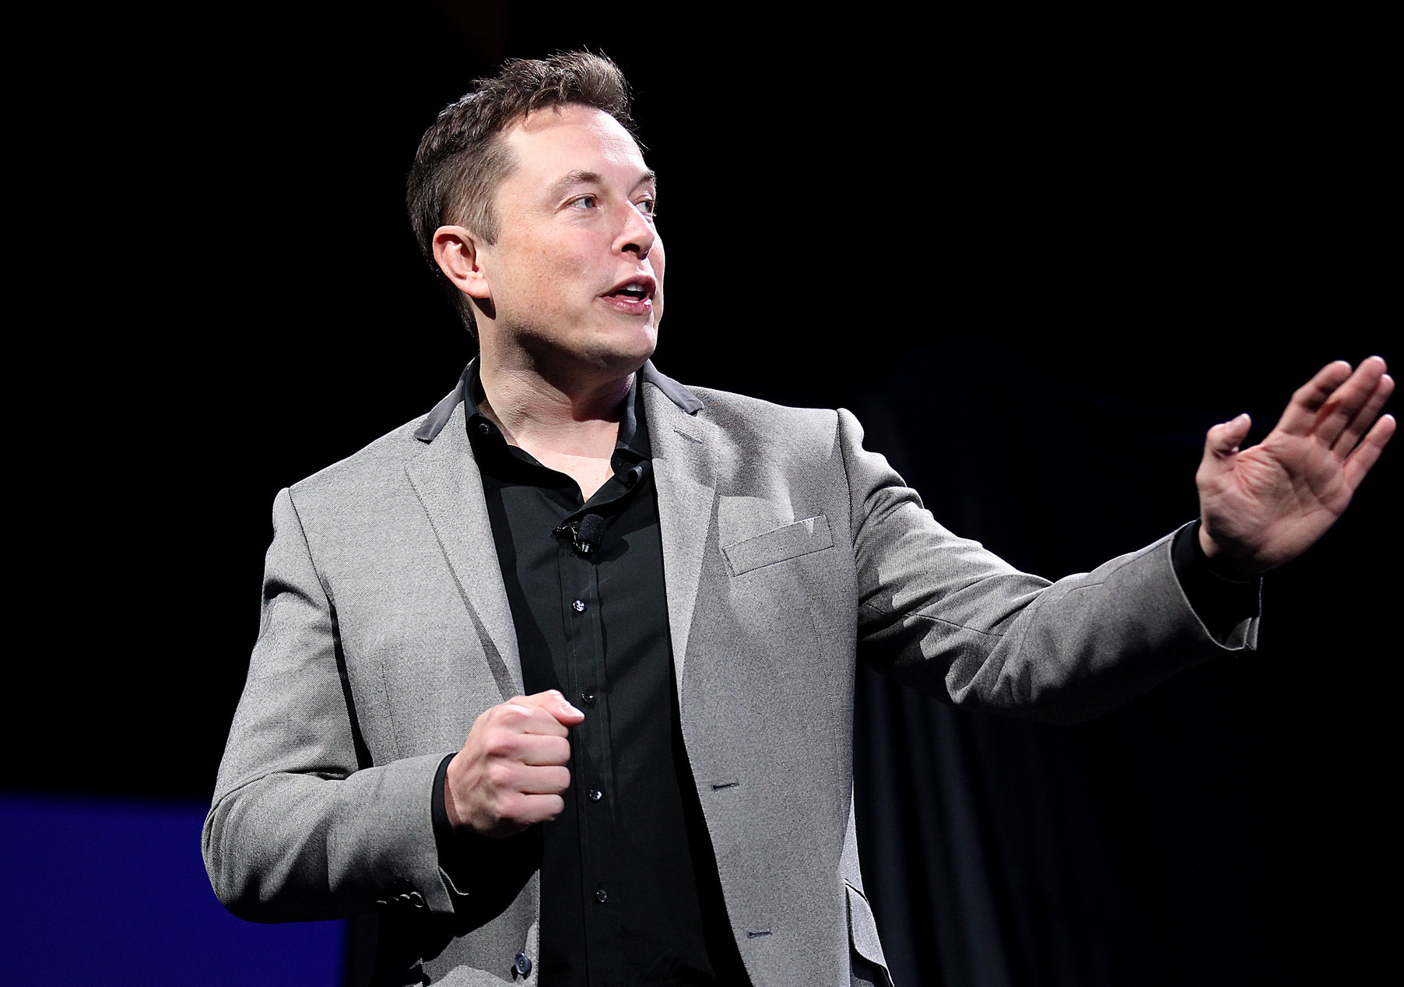

Slide 19

Little twin with 2 moons (phobos & deimos); 6,779km of diameter.
22.9million km from sun with orbital speed 24.077km/s.
Temp: -130ºC to 27ºC.
Day length of 24hr 37min; Year length 687 Earth days.
Seasonal change.

Slide 20
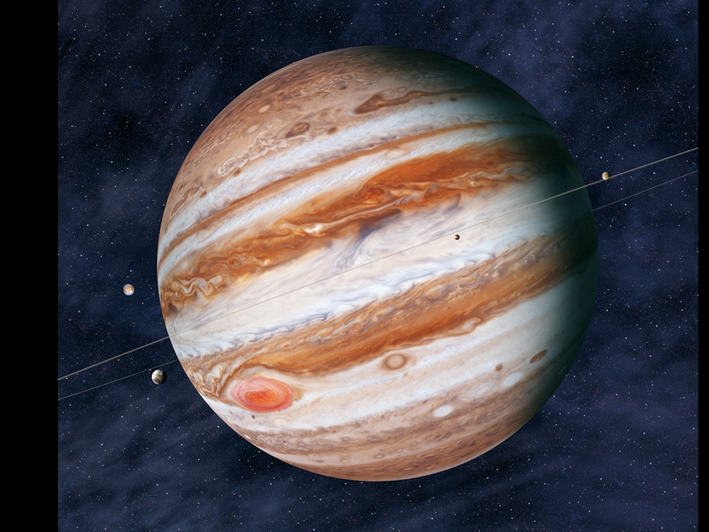

Slide 21

Largest of all; Gravity of 24.79m/s².
Diameter of 1,39,322km.
Over 200 moons only 67 are named.
Fourth brightest object to us.
Orbital period of 11.86 earth years.
Atmosphere: 89.9% hydrogen 10.2% helium.

Slide 22

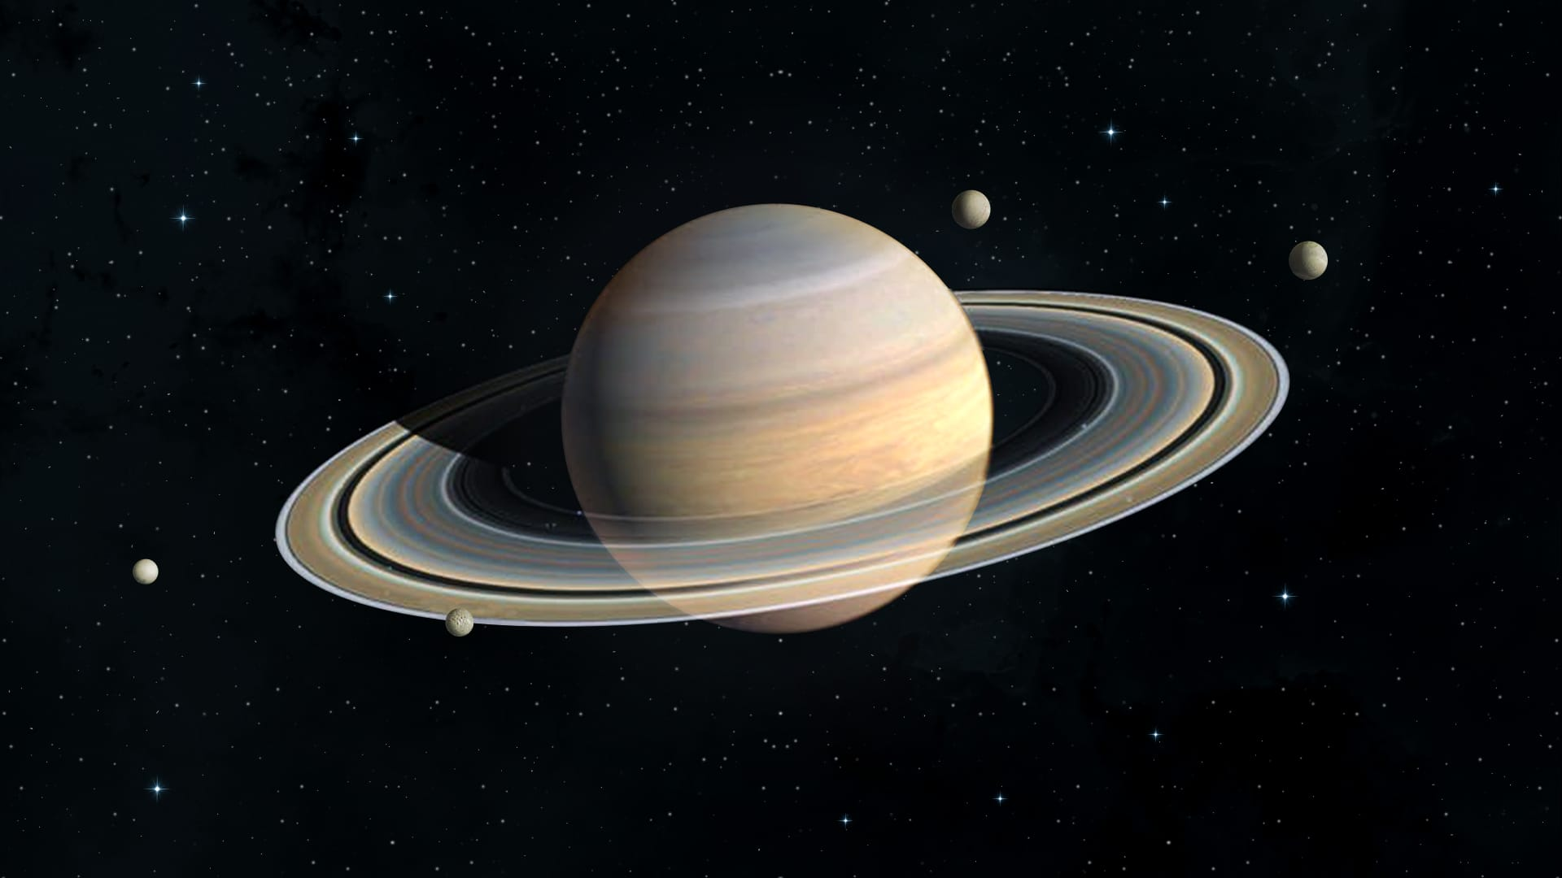

Slide 23

Second largest of 1,20,536km diameter;
Gravity of 10.44 m/s².
At least 145 moons confirmed.
7 main rings.
Atmosphere: 96% hydrogen, 3% helium.
Temp: -139ºC.
Life possible on some of it’s moons.

Slide 24
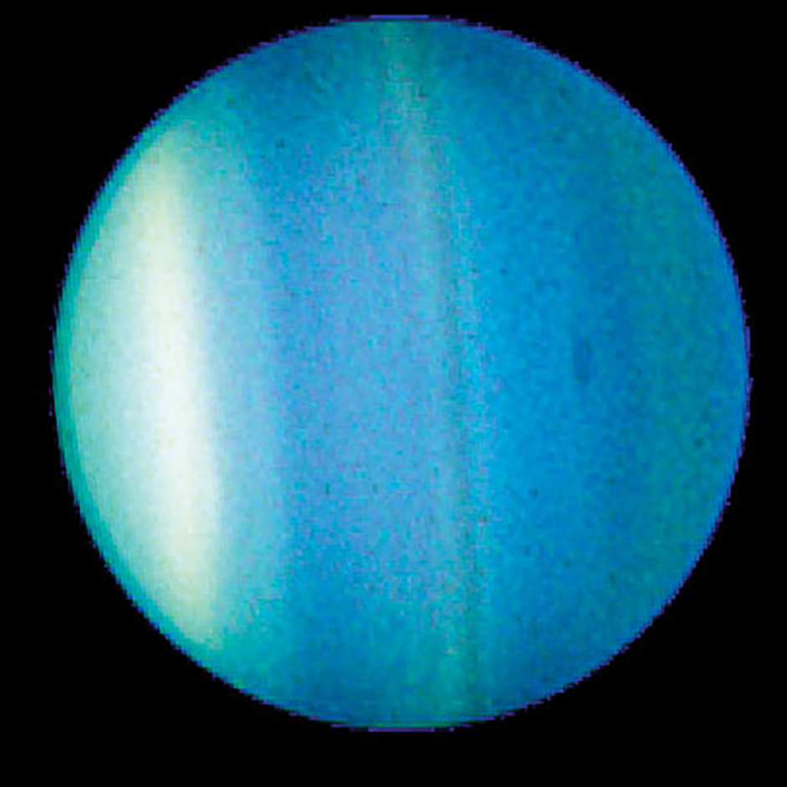

Slide 25

Third largest of 31,763km diameter.
Sunlight takes 2hr 40min to reach as 19 AU distance.
Day length 17 earth hr. orbit period of 84 earth years.
28 moons; 13 rings.
Unusual Magnetic field tilt at 60º

Slide 26
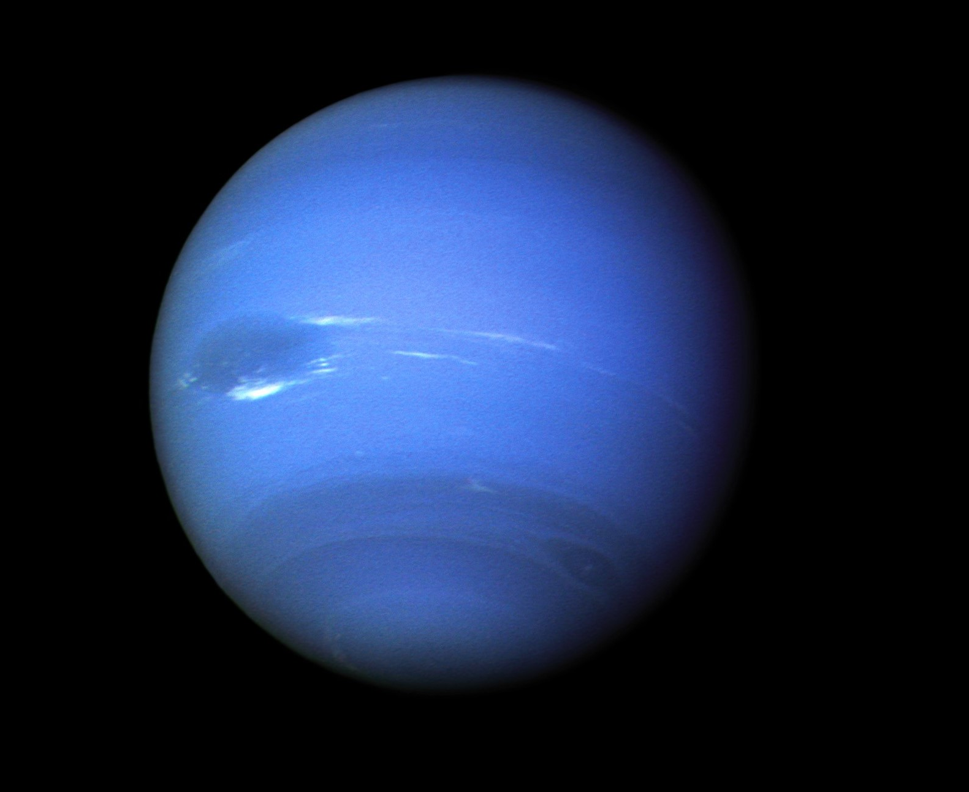
Math Explore

Slide 27

Diameter of 30,775km.
30AU from sun. Sun light takes 4hr to reach.
Day length of 16hr; Orbital period of 165 earth years.
16 moons; 9 rings.
Strong magnetic field.

Slide 28
According to International Astronomical Unit planet possess
Orbit around its host star.
Be mostly round.
Be big enough that its gravity cleared away any other objects in it path.

Slide 29
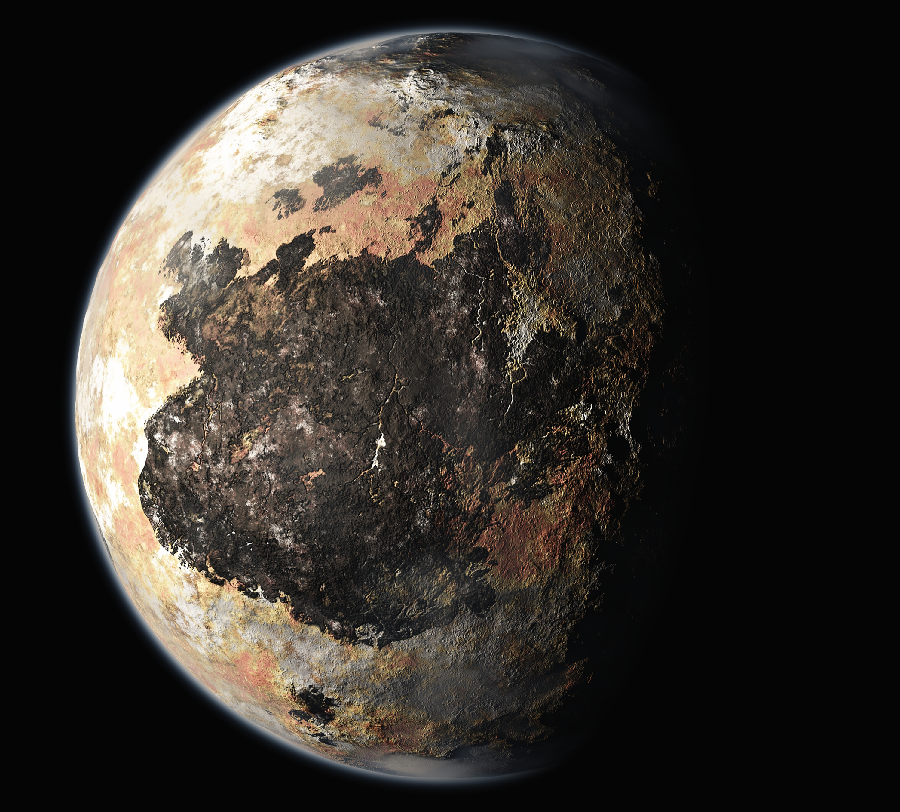
Forgotten One

Slide 30
Diameter of 2,377km.
5 moons.
Orbital period of 248 earth years and rotation of 6.4 earth days.

Slide 31
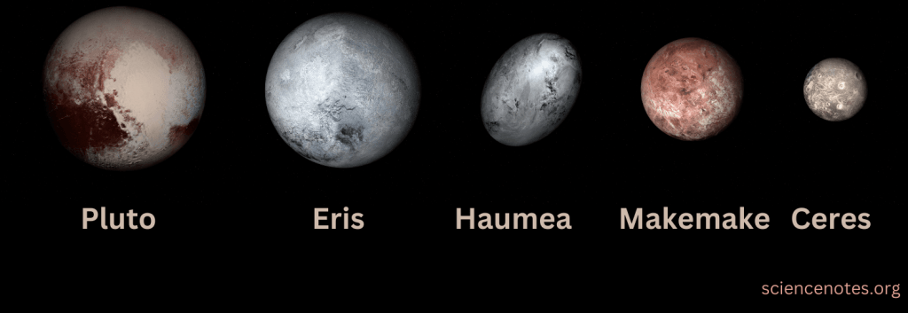

Slide 34
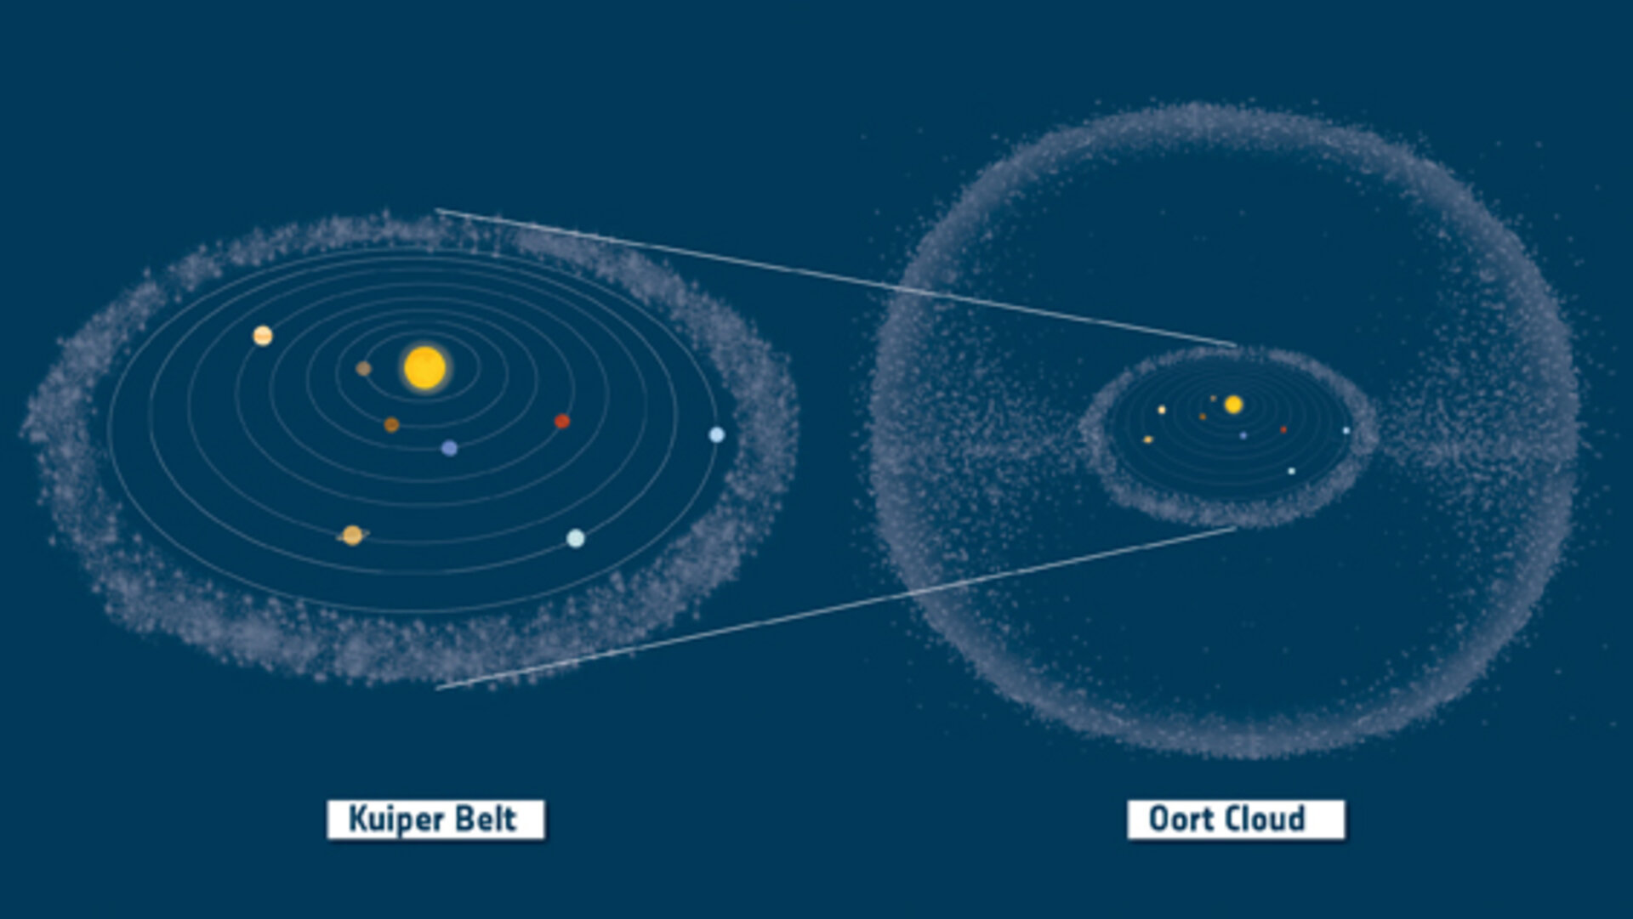

Slide 35
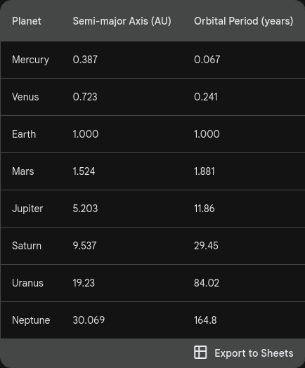

Slide 36
